Slide 1
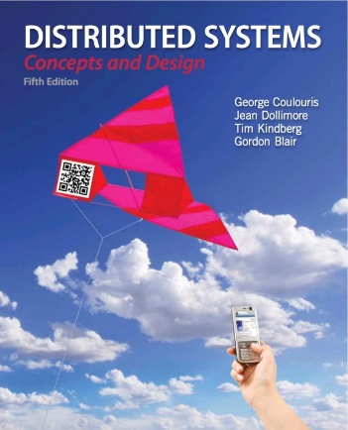
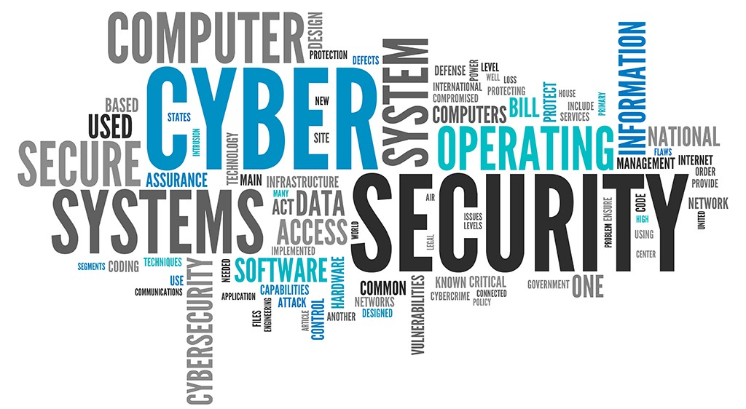


Distributed Systems:
Security
Revised and Updated by: Rajkumar Buyya
Chapter 2 Revision: Security Model
Most concepts are
drawn from Chapter 11

Slide 2
Some Cyber Security Facts https://www.cybintsolutions.com/cyber-security-facts-stats/
1. 95% of breached records came from only three industries in 2016
  Government, retail, and technology (high level of personal identifying information contained in their records)
2. There is a hacker attack every 39 seconds
3. 43% of cyber attacks target small business
  64% of companies have experienced web-based attacks. 62% experienced phishing & social engineering attacks. 59% of companies experienced malicious code and botnets and 51% experienced denial of service attacks.

Slide 3
Some Cyber Security Facts https://www.cybintsolutions.com/cyber-security-facts-stats/
4. The average cost of a data breach in 2020 exceeded $150 million
  As more business infrastructure gets connected, Juniper Research data suggests that cybercrime will cost businesses over $2 trillion total in 2019.
  June 2019: The Australian National University has been hit by a massive data hack, with unauthorised access to significant amounts of personal details dating back 19 years.
5. Since COVID-19, the US FBI reported a 300% increase in reported cybercrimes
  As if a pandemic wasn’t scary enough, hackers leveraged the opportunity to attack vulnerable networks as office work moved to personal homes.

Slide 4
Some Cyber Security Facts https://www.cybintsolutions.com/cyber-security-facts-stats/
6. Over 75% of healthcare industry has been infected with malware over last year
7. Large-scale DDoS attacks increase in size by 500%
8. Approximately $6 trillion is expected to be spent globally on cybersecurity by 2021

Slide 5
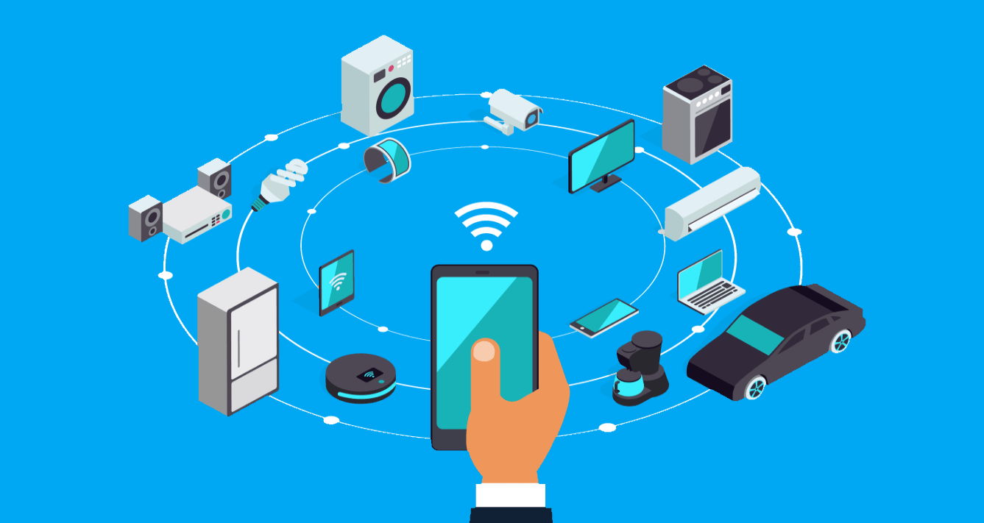
Some Cyber Security Facts https://www.cybintsolutions.com/cyber-security-facts-stats/
9. Unfilled cybersecurity jobs worldwide is already over 4 million
  More than 500,000 cybersecurity jobs in the U.S. are unfilled, and postings are up 74% over the past five years
10. Connected IoT devices will reach 75 billion by 2025
  The risk is real with
  IoT and its growing.
  Smart Healthcare
  Smart City
  Smart Transport

Slide 6
Some Cyber Security Facts https://www.cybintsolutions.com/cyber-security-facts-stats/
11. 95% of cybersecurity breaches are due to human error
  Cyber-criminals and hackers will infiltrate your company through your weakest link, which is almost never in the IT department.
12. More than 77% of organizations do not have a Cyber Security Incident Response plan
  What’s worse? An estimated 54 percent of companies say they have experienced one or more attacks in the last 12 months.
13. Total cost for cybercrime committed globally will reach $6 trillion by 2021
  As long as you’re connected to the Internet, you can become a victim of cyber attacks.

Slide 7

‘Zoom bombers’ invade virtual classrooms’: Unauthorized Participants and Disruptions

Slide 8

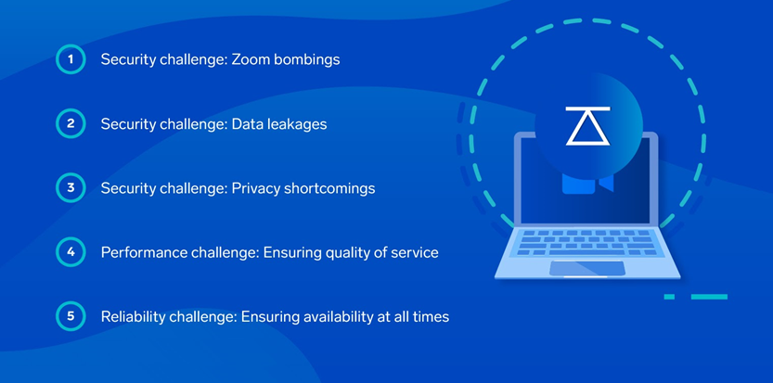
Zoom Challenges
https://www.sumologic.com/blog/zoom-security-challenges/

Slide 9
Learning objectives
Security model
  Types of threat
Basic techniques
  Cryptographic techniques
    Secrecy
    Authentication
    Certificates and credentials
    Access control
  Audit trails
Symmetric and asymmetric encryption concepts
Digital signatures
Approaches to secure system design
Pragmatics and case studies (Kerberos and Secure Socket Layer)

Slide 10
Why Security is so important in DS?
Security Goal: Restrict access to information/resources to just to those entities that are authorized to access.
There is a pervasive need for measures to guarantee the privacy, integrity, and availability of resources in DS.
Security attacks take various forms: Eavesdropping, masquerading, tampering, and denial of service.
Designers of secure distributed systems must cope with the exposed interfaces and insecure network in an environment where attackers are likely to have knowledge of the algorithms used to deploy computing resources.
Cryptography provides the basis for the authentication of messages as well as their secrecy and integrity.

Slide 11
How is security in real world?
In the physical world, organisations adopt “security policies” that provide for the sharing of resources within specified limits.
  Company may permit entry to its building for its employees and for accredited visitors.
  A security policy for documents may specify groups of employees who can access classes of documents or it may be defined for individual documents and users.
Security policies are enforced with security mechanisms.
  Access to building may be controlled by a reception clerk, who issues badges to accredited visitors, and enforced by security guard or by electronic door locks.
In electronic world, the distinction between security policy and mechanisms is equally important.

Slide 12
Chapter 2 Revision: Objects and principals
Access rights
Object
invocation
Client
result
Server
Principal (user)
Network
Principal (server)
Object (or resource)
  Mailbox, system file, part of a commercial web site
Principal
  User or process that has authority (rights) to perform actions
  Identity of principal is important
*
Notes:
Objects such as mailboxes, shared web pages, etc.
Introduces concept of a Principal - a user or a process with authority (rights)

Slide 13
Chapter 2 Revision: The enemy
Copy of
m
The enemy
m’
Process
p
m
Process
q
Communication channel
Attacks
  On applications that handle financial transactions or other information whose secrecy or integrity is crucial
Enemy (or adversary)
Threats
  To processes, to communication channels, denial of service
*
Notes:
Open distributed systems have exposed communication channels and ports.
The enemy can attempt to eavesdrop, impersonate principals, tamper with messages, flood ports with messages

Slide 14
Chapter 2 Revision: Secure channels
Cryptography
Principal
A
The enemy
Principal
B
Process
p
Secure channel
Process
q
Properties
    Each process is sure of the identity of the other
    Data is private and protected against tampering
    Protection against repetition and reordering of data
Employs cryptography
    Secrecy based on cryptographic concealment
    Authentication based on proof of ownership of secrets
Ownership of secrets:
  Conventional shared crypto keys
  Public/private key pair
Cryptographic concealment is based on:
  Confusion and diffusion
*
Notes:
Popup 1 identifies crypto principles of diffusion and confusion
Popup 2 expands on shared secrets
Cryptographic concealment is based on:
Confusion and diffusion
Shared secrets:
Conventional crypto keys (not algorithms)
Public/private pair --( illustration - a sheet of paper torn in half)

Slide 15
Threats and Attacks
Security Threats - Three broad Classes:
  Leakage: Acquisition of information by unauthorised recipients
  Tampering: Unauthorised alteration of information
  Vandalism: Interference with the proper operation of systems
Method of Attacks are listed below:
Eavesdropping - A form of leakage
  obtaining private or secret information or copies of messages without authority.
Masquerading – A form of impersonating
  assuming the identity of another user/principal – i.e, sending or receiving messages using the identity of another principal without their authority.
Message tampering
  altering the content of messages in transit
    man in the middle attack (tampers with the secure channel mechanism)
Replaying
  storing secure messages and sending them at a later date
Denial of service - Vandalism
  flooding a channel or other resource, denying access to others

Slide 16
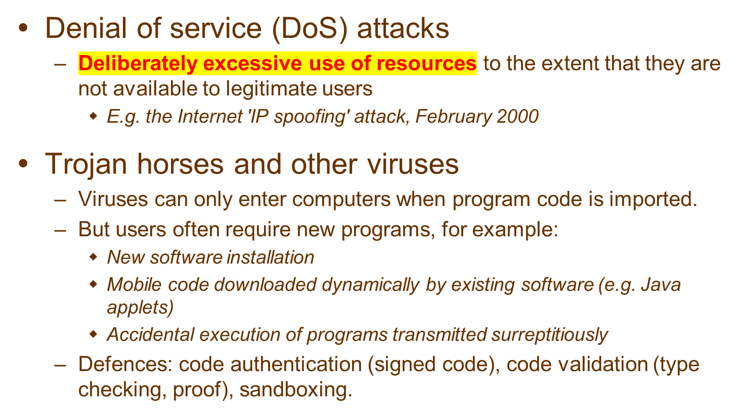
Threats not defeated by secure channels or other cryptographic techniques
Notes:
DoS: a form of attack in which the enemy interferes with the activities of authorized users by making excessive and pointless invocations on services or message transmissions in a network, resulting in overloading of physical resources (network bandwidth, server processing capacity). Such attacks are usually made with the intention of delaying or preventing actions by other users. For example, the operation of electronic door locks in a building might be disabled by an attack that saturates the computer controlling the electronic locks with invalid requests.
Mobile code may easily play a Trojan horse role, purporting to fulfil an innocent purpose but in fact including code that accesses or modifies resources that are legitimately available to the host process but not to the originator of the code. The methods by which such attacks might be carried out are many and varied, and the host environment must be very carefully constructed in order to avoid them. Many of these issues have been addressed in Java and other mobile code systems, but the recent history of this topic has included the exposure of some embarrassing weaknesses. This illustrates well the need for rigorous analysis in the design of all secure systems.

Slide 17
The February 2000 IP Spoofing DDoS attack
(creation of IP packets with a false source IP address)
Campus intranets
Firewall
IP = n.n.n.i
amazon.com
IP = x.x.x.x
Internet
yahoo.com
IP = y.y.y.y
Untrue!
Compromised host on each local network
sends repeatedly (for all i):
Echo request | source = x.x.x.x | destination =
n.n.n.i
resulting in:
Echo reply
| source =
n.n.n.i |
destination = x.x.x.x
Notes:
hidden

Slide 18
Securing Electronic Transactions
Email
  Traditionally no support for security.
  But it is important to Keep messages secret.
  Modern mail clients incorporate cryptography.
Purchase of goods and services
Banking transactions
Micro-transactions
  Currently access to Web pages is not charged, but the development of Web as a highly quality publishing medium surely needs it.
  The price of such services may amount to only a fraction of cent and the payment overhead must be low (for this to be feasible).
  How to manage “fraudulent vendors” – who obtain payment with no intension of supplying good.

Slide 19
Sensible security policies for Internet vendors and buyers leads to various requirements
Authenticate the vendor to the buyer
Keep buyer’s credit card details secure
Ensure that content is delivered to the buyer
Authenticate the identity of account holder before giving them access to their account

Slide 20
Designing Secure Systems
Immense strides have been made in recent years in the development of cryptographic techniques and their applications, yet design of secure systems remains an inherently difficult task.
  Aim: exclude all possible attacks and loop holes.
  This looks like programmer aiming to exclude all bugs from his/her program.
Security is about avoiding disasters and minimizing mishaps. When designing for security it is necessary to assume the worst.
The design of security system is an exercise in balancing costs against threats:
  A cost (computational and network usage) is incurred for their use.
  Inappropriately specified security measures may exclude legitimate users from performing necessary actions.

Slide 21
Worst case assumptions and design guidelines
Interfaces are exposed
  DSs made up of processes with open interfaces
Networks are insecure
  Messages sources can be falsified.
Limit the lifetime and scope of each secret
  Passwords and keys validity – needs to be time restricted.
Algorithms and code are available to hackers
Attackers may have access to large resources
Minimise the trusted base.

Slide 22
Overview of Security Techniques
Digital cryptography provides the basis for most computer security mechanisms, but it is important to note that computer security and cryptography are distinct subjects.
  Cryptography is an art of encoding information in a format that only intended recipient can access.
  Cryptography can be used to provide a proof of authenticity of information in a manner analogous to the use of signature in conventional transactions.
We will focus more on security of distributed systems and applications rather than cryptography algorithms.

Slide 23
Cryptography: Introduction
Cryptography: encryption and decryption
Encryption is the process of encoding a message in such a way as to hide its contents.
Modern cryptography includes several secure algorithms for encrypting and decrypting messages. They are based on keys.
A cryptography key is a parameter used in an encryption algorithm in such a way that the encryption cannot be reversed without a knowledge of the key.

Slide 24
Classes of Cryptography Algorithms
There are two main classes:
  Shared Secret Keys:
    The sender and recipient share a knowledge of the key and it must not be revealed to anyone.
  Public/Private Key Pair:
    The sender of a message uses a recipient’s public key to encrypt the message.
    The recipient uses a corresponding private key to decrypt the message.
Uses of Cryptography:
  Secrecy and integrity (to stop eavesdropping and tampering) + also use redundant information (checksums) for maintaining integrity.
  Authentication
  Digital Signatures

Slide 25
Security notations –
Familiar names and notations in security literature
K_{A}
Alice’s secret key
K_{B}
Bob’s secret key
K_{AB}
Secret key shared between Alice and Bob
K_{Apriv}
Alice’s private key (known only to Alice)
K_{Apub}
Alice’s public key (published by Alice for all to read)
{
M
}
_{K}
Message
M
encrypted with key
K
[
M
]_{K}
Message
M
signed with key
K
Alice
First participant
Bob
Second participant
Carol
Participant in three- and four-party protocols
Dave
Participant in four-party protocols
Eve
Eavesdropper
Mallory
Malicious attacker
Sara
A server
Notes:
Optional slide

Slide 26
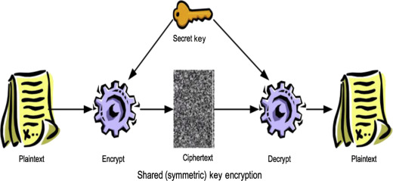
Scenario 1:
Secret communication with a shared secret key
Alice wishes to send some information secretly. Alice and Bob share a secret key K_{AB}.
Alice uses K_{AB} and an agreed encryption function E(K_{AB}, M) to encrypt and send any number of messages {M_{i}}_{KAB} to Bob.
Bob reads the encrypted messages using the corresponding decryption function D(K_{AB}, M).
Alice and Bob can go on using K_{AB} as long as it is safe to assume that K_{AB} has not been compromised.
Issues:
  Key distribution: How can Alice send a shared key K_{AB} to Bob securely?
  Freshness of communication: How does Bob know that any {M_{i}} isn’t a copy of an earlier encrypted message from Alice that was captured by Mallory and replayed later? Problem: if the message is a request to pay some money to someone. Mallory might trick Bob into paying twice?
Notes:
Popup: Bullet points

Slide 27
Scenario 2: Authenticated communication with a server
(Server knows secret keys of all parties)
Bob is a file server; Sara is an authentication service. Sara shares secret key K_{A} with Alice and secret key K_{B} with Bob.
Alice sends an (unencrypted) message to Sara stating her identity and requesting a ticket for access to Bob. 
Sara sends a response to Alice. {{Ticket}_{KB}, K_{AB}}_{KA}. It is encrypted in K_{A} and consists of a ticket (to be sent to Bob with each request for file access) encrypted in K_{B} and a new secret key K_{AB}.
Alice uses K_{A} to decrypt the response.
Alice sends Bob a request R to access a file: {Ticket}_{KB}, Alice, R.
The ticket is actually {K_{AB}, Alice}_{KB}. Bob uses K_{B} to decrypt it, checks that Alice's name matches and then uses K_{AB} to encrypt responses to Alice.
This is a simplified version of the Needham and Schroeder (and Kerberos) protocol.
Timing and replay issues – addressed in N-S and Kerberos.
Not suitable for e-commerce because authentication service doesn't scale…
Notes:
Popup 1 defines ticket
Popup 2 bullet points

Slide 28
Scenario 2: Illustration
Sara
Sara knows K_{A} and K_{B}
Can create K_{AB}
1
2: {{Ticket}_{KB}, K_{AB}}_{KA}
Alice
K_{A}
4
{Ticket}_{KB}, Alice, R.
3
5
Bob
{Response Msg} K_{AB}
K_{B}
The ticket is actually {K_{AB}, Alice}_{KB}.

Slide 29
Limitation of Needham and Schroeder Protocols
It depends upon prior knowledge by the authentication server Sara of Alice’s and Bob’s keys. This is feasible in a single organisation where Sara run a physically secure computer and is managed by a trusted principal.
  Not suitable in E-commerce or other wide area applications.
Usefulness of challenges: They introduced the concept of a cryptographic challenge. That means in step 2 of our scenario, where Sara issues a ticket to Allice encypted in Alice’s secret key, KA .

Slide 30
Scenario 3:
Authenticated communication with public keys
Bob has a public/private key pair <K_{Bpub}, K_{Bpriv}> & establishes K_{AB} as follows:
Alice obtains a certificate that was signed by a trusted authority stating Bob's public key K_{Bpub}
Alice creates a new shared key K_{AB} , encrypts it using K_{Bpub} using a public-key algorithm and sends the result to Bob.
3. Bob uses the corresponding private key K_{Bpriv} to decrypt it.
(If they want to be sure that the message hasn't been tampered with, Alice can add an agreed value to it and Bob can check it.)
Mallory might intercept Alice’s initial request to a key distribution service for Bob’s public-key certificate and send a response containing his own public key. He can then intercept all the subsequent messages.
Notes:
Popup bullet point

Slide 31
Scenario 4:
Digital signatures with a secure digest function
Alice wants to publish a document M in such a way that anyone can verify that it is from her.
Alice computes a fixed-length digest of the document Digest(M).
Alice encrypts the digest in her private key, appends it to M and makes the resulting signed document (M, {Digest(M)}_{KApriv}) available to the intended users.
Bob obtains the signed document, extracts M and computes Digest(M).
Bob uses Alice's public key to decrypt {Digest(M)}_{KApriv} and compares it with his computed digest. If they match, Alice's signature is verified.
Notes:
Popup 2 bullet points

Slide 32


A Certificate with Digital signatures
Transcript
Student: Rajkumar Buyya
1. COMP90015: Distributed Systems: 95 marks
2….
Computed message digest:
{491103ea18660f4c4d9f3c32af5d28f5}_{KUniMelbpriv}
IBM (employer) uses UniMelb's public key to decrypt {Digest(M)} _{KUniMelbpriv} and compares it with his computed digest of Transcript content. If they match, UniMelb's signature is verified. Then IBM trusts and hires you☺
Algo MD5 128 bit from: https://www.freeformatter.com/message-digest.html
The MD5 hashing algorithm is a one-way cryptographic function that accepts a message of any length as input and returns as output a fixed-length digest value to be used for authenticating the original message.

Slide 33
Cryptographic Algorithms
Message M, key K, published encryption functions E, D
Symmetric (secret key)
    E(K, M) = {M}_{K} D(K, E(K, M)) = M
  Same key for E and D
  M must be hard (infeasible) to compute if K is not known.
  Usual form of attack is brute-force: try all possible key values for a known pair M, {M}_{K}. Resisted by making K sufficiently large ~ 128 bits
Asymmetric (public key)
  Separate encryption and decryption keys: K_{e}, K_{d}
    D(K_{d}. E(K_{e}, M)) = M
  depends on the use of a trap-door function to make the keys. E has high computational cost. Very large keys > 512 bits
Hybrid protocols - used in SSL (now called TLS)
  Uses asymmetric crypto to transmit the symmetric key that is then used to encrypt a session.
Notes:
Popup bullet points defining symmetric and asymmetric algorithms

Slide 34
Public Key Infrastructure (PKI)
PKI allows you to know that a given public key belongs to a given user
PKI builds on asymmetric encryption:
  Each entity has two keys: public and private
  Data encrypted with one key can only be decrypted with other.
  The private key is known only to the entity
The public key is given to the world encapsulated in a X.509 certificate
Owner

Slide 35
Public Key Infrastructure (PKI) Overview
X.509 Certificates
Certificate Authorities (CAs)
Certificate Policies
  Namespaces
Requesting a certificate
  Certificate Request
  Registration Authority
Owner

Slide 36
Certificates
Figure 7.4 Alice’s bank account certificate
Certificate: a statement signed by an appropriate authority.
Certificates require:
  An agreed standard format
  Agreement on the construction of chains of trust.
  Expiry dates, so that certificates can be revoked.
1.
Certificate type
:
Account number
2.
Name
:
Alice
3.
Account
:
6262626
4.
Certifying authority
:
Bob’s Bank
5.
Signature
:
{Digest(field 2 + field 3)}
K_{Bpriv}
Public-key certificate for Bob's Bank
1.
Certificate type
:
Public key
2.
Name
:
Bob’s Bank
3.
Public key
:
K_{Bpub}
4.
Certifying authority
:
Fred – The Bankers Federation
5.
Signature
{Digest(field 2 + field 3)}
:
K_{Fpriv}
Notes:
Popup shows Alice's bank account certificate

Slide 37
X509 Certificate format
S
u
b
jec
t
D
i
s
t
i
n
g
u
is
he
d N
a
m
e,
Pu
b
l
ic
K
e
y
Iss
ue
r
D
i
s
t
i
n
g
u
is
he
d N
a
m
e,
Si
g
n
at
u
r
e
Pe
ri
o
d
o
f
v
a
li
d
i
t
y
N
o
t
Be
f
o
r
e
Da
t
e,
No
t
A
f
t
e
r
D
ate
A
d
m
i
ni
str
a
t
ive
i
n
fo
rma
ti
o
n
V
er
si
o
n
,
S
e
r
i
a
l
N
u
mb
e
r
Ex
t
en
d
e
d
I
n
f
or
m
a
t
i
o
n
It provides a public key to a named entity called the subject.
The binding is in the signature, which is issued by another
entity called issuer (CA, Certificate Authority)

Slide 38

Certificates
Similar to passport or driver’s license
State of Victoria
Name
Issuer
Public Key
Signature
Rajkumar Buyya
111, Barry Street
Carlton
State of
Victoria
Seal
BD 01-0X-197X
Male 165cms, 65Kg
Valid: Jun 30, 2030

Slide 39
An example of Certificate
Certificate:
Data:
Version: 3 (0x2)
Serial Number: 28 (0x1c)
Signature Algorithm: md5WithRSAEncryption
Issuer: C=US, O=Globus, CN=Globus Certification Authority
Validity
Not Before: Apr 22 19:21:50 2020 GMT
Not After : Apr 22 19:21:50 2030 GMT
Subject: /O=Grid/O=Globus/OU=cis.unimelb.edu.au/CN=Rajkumar Buyya
Subject Public Key Info:
Public Key Algorithm: RSAEncryption
RSA Public Key: (1024 bit)
Modulus (1024 bit):
00:bf:4c:9b:ae:51:e5:ad:ac:54:4f:12:52:3a:69:
<snip>
b4:e1:54:e7:87:57:b7:d0:61
Exponent: 65537 (0x10001)
Signature Algorithm: md5WithRSAEncryption
59:86:6e:df:dd:94:5d:26:f5:23:c1:89:83:8e:3c:97:fc:d8:
<snip>
8d:cd:7c:7e:49:68:15:7e:5f:24:23:54:ca:a2:27:f1:35:17:
Validity Start
Validity End

Slide 40
Certificates as credentials
Certificates can act as credentials
  Evidence for a principal's right to access a resource
The two certificates shown in the last slide could act as credentials for Alice to operate on her bank account
  She would need to add her public key certificate
Alice’s bank account certificate
1.
Certificate type
:
Account number
2.
Name
:
Alice
3.
Account
:
6262626
4.
Certifying authority
:
Bob’s Bank
5.
Signature
:
{Digest(field 2 + field 3)}
K_{Bpriv}
Public-key certificate for Bob's Bank
1.
Certificate type
Public key
:
2.
Name
:
Bob’s Bank
3.
Public key
:
K_{Bpub}
4.
Certifying authority
:
Fred – The Bankers Federation
5.
Signature
{Digest(field 2 + field 3)}
:
K_{Fpriv}

Slide 41
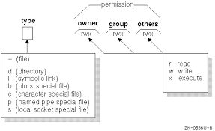
Access control
Protection domain
  A set of <resource, rights> pairs
Two main approaches to implementation:
  Access control list (ACL) associated with each object
    E.g. Unix file access permissions 
    For more complex object types and user communities, ACLs can complex
  Capabilities associated with principals
    Like a key – allowing the holder access to certain operations on a specified resource.
    Format: <resource id, permitted operations, authentication code>
drwxr-xr-x gfc22 staff 264 Oct 30 16:57 Acrobat User Data
-rw-r--r-- gfc22 unknown 0 Nov 1 09:34 Eudora Folder
-rw-r--r-- gfc22 staff 163945 Oct 24 00:16 Preview of xx.pdf
drwxr-xr-x gfc22 staff 264 Oct 31 13:09 iTunes
-rw-r--r-- gfc22 staff 325 Oct 22 22:59 list of broken apps.rtf
Notes:
Popup shows Unix file access control list

Slide 42
Case study: Kerberos authentication and key distribution service
Secures communication with servers on a local network
  Developed at MIT in the 1980s to provide security across a large campus network > 5000 users
  based on Needham - Schroeder protocol
Standardized and now included in many operating systems
  Internet RFC 1510, OSF DCE
  BSD UNIX, Linux, Windows 2000, XP, Windows 8, Windows 10
Kerberos server creates a shared secret key for any required server and sends it (encrypted) to the user's computer
User's password is the initial secret shared with Kerberos

Slide 43
System architecture of Kerberos
Needham - Schroeder protocol
TGS: Ticket-granting service
Kerberos Key Distribution Centre
Authentication
1. A->S:
A, B, N_{A}
Step A
database
Ticket-
2. S->A:
{N_{A} , B, K_{AB},
Authen-
granting
1. Request for
tication
service T
{K_{AB}, A}_{KB}}_{KA}
TGS ticket
service A
2. TGS
3. A->B:
{K_{AB}, A}_{KB}
ticket
Step B
4. B->A:
{N_{B}}_{KAB}
3. Request for
5. A->B:
{N_{B} - 1}_{KAB}
Login
server ticket
4. Server ticket
Step C
session setup
5.
Service
Server
request
Service
session setup
function
Request encrypted with session key
DoOperation
Step A once per login session
Reply encrypted with session key
Step B once per server session
Client
Server
Step C once per server transaction

Slide 44
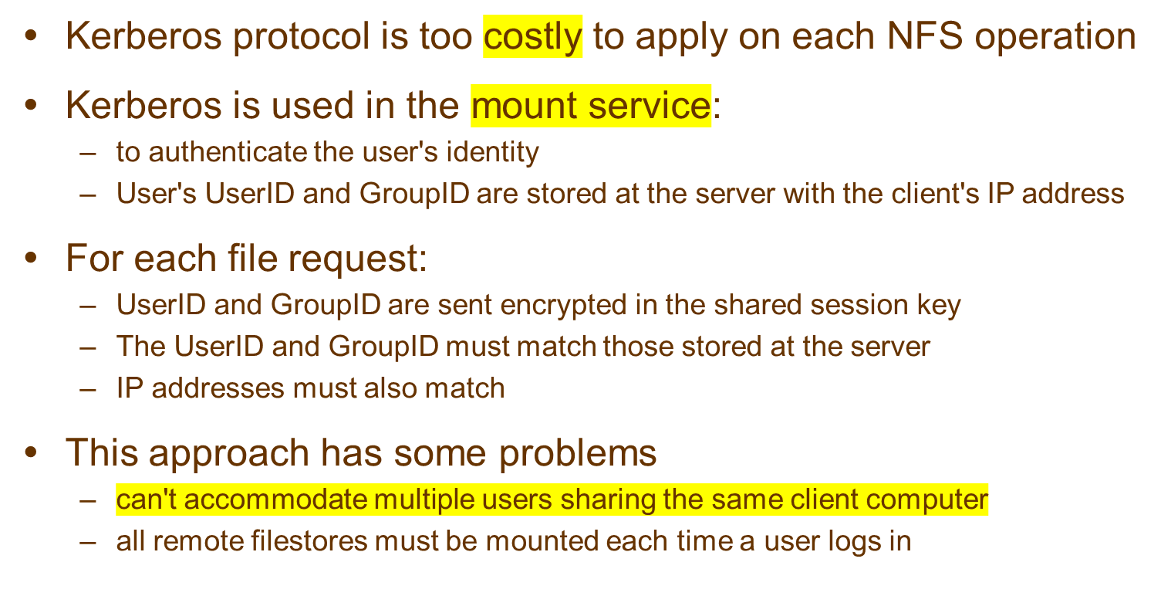
Kerberized NFS

Slide 45
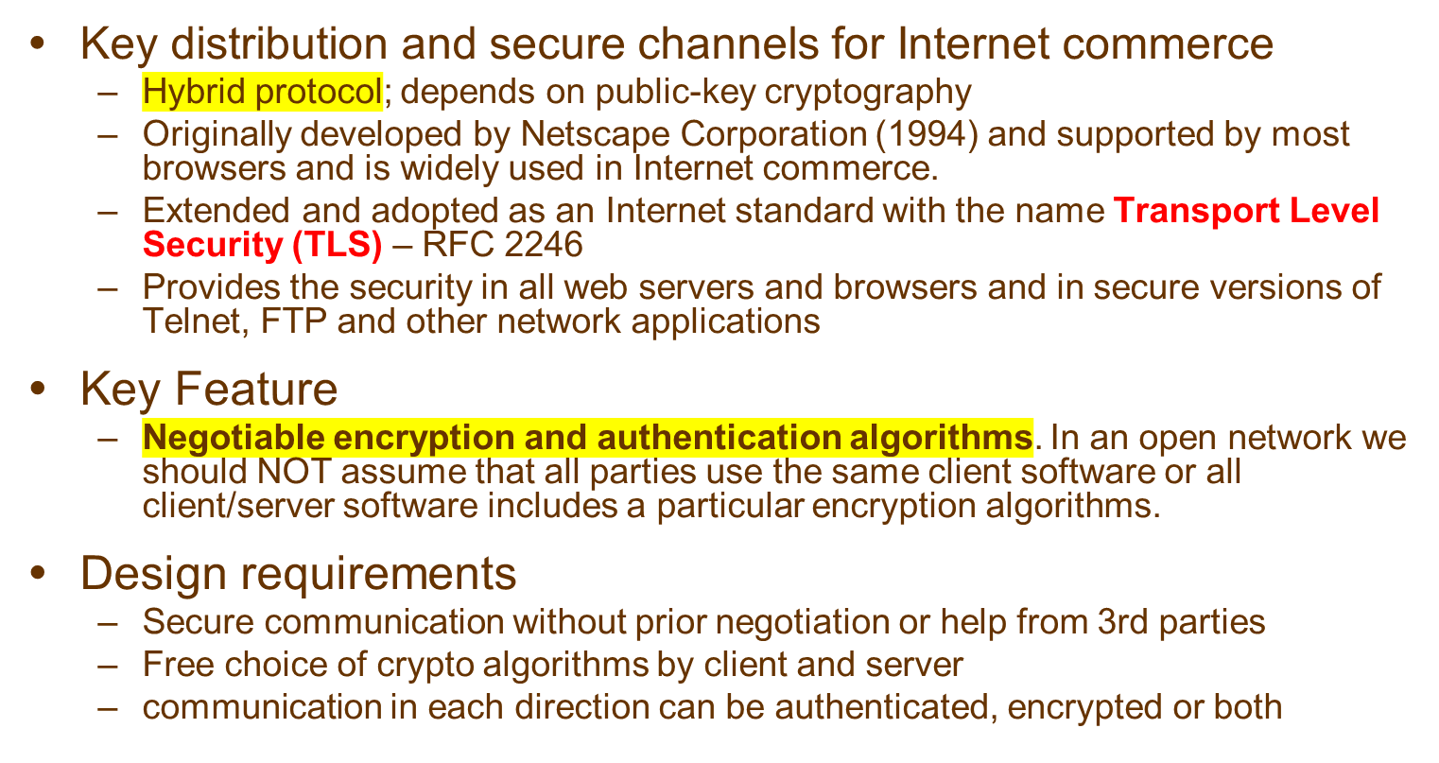
Case study: The Secure Socket Layer (SSL)

Slide 46
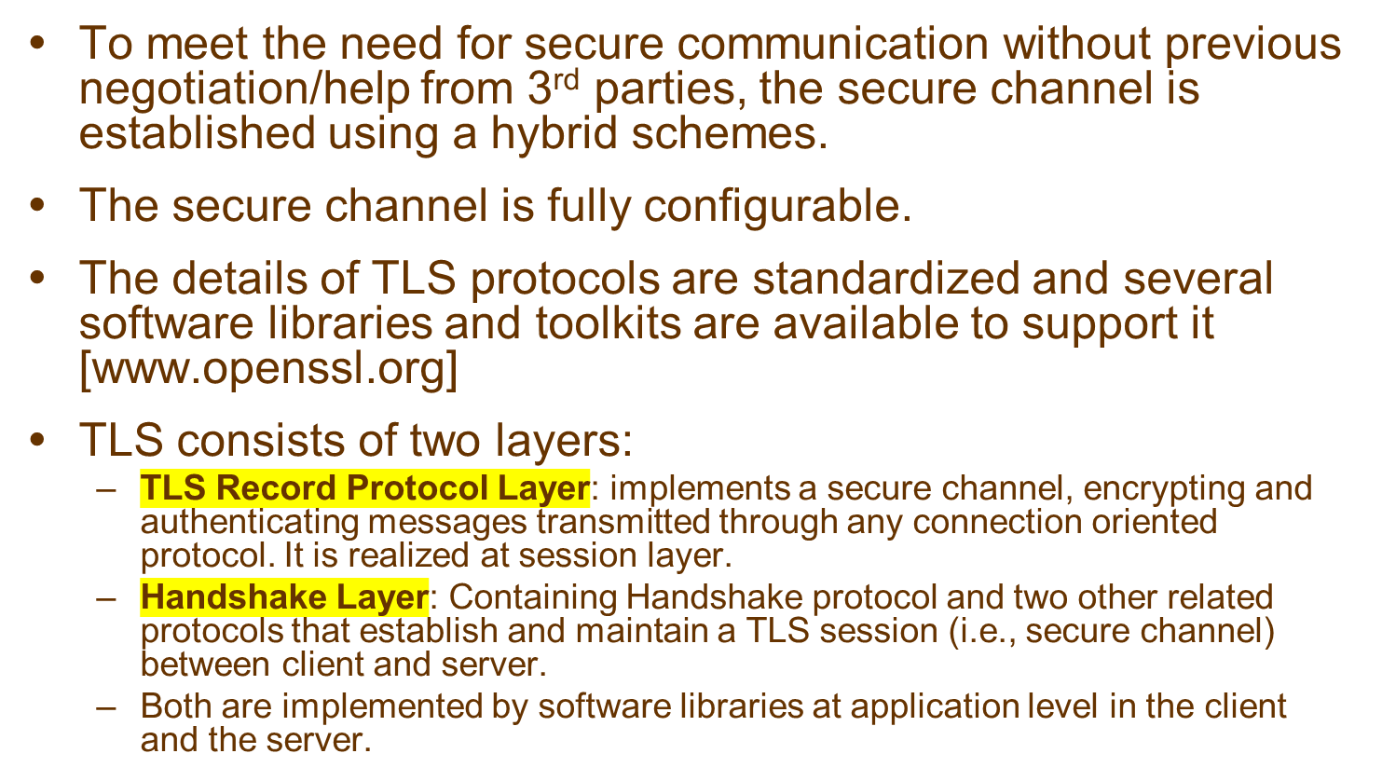
Bootstrapped secure communication

Slide 47
TLS protocol stack
changes the
secure channel
to a new spec
negotiates cipher
suite, exchanges certificates and key masters
TLS
Handshake
TLS Change
TLS Alert
Cipher Spec
Protocol
HTTP
Telnet
protocol
implements the
secure channel
TLS Record Protocol
Transport layer (usually TCP)
Network layer (usually IP)
TLS protocols:
Other protocols:

Slide 48
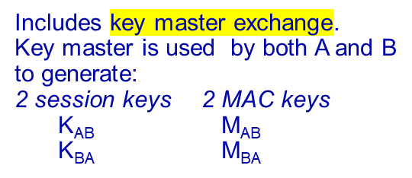
TLS/SSL handshake protocol
(Handshake is performed over an existing connection)
ClientHello
Establish protocol version, session ID,
cipher suite, compression method,
ServerHello
exchange random start values
Certificate
Certificate Request
Optionally send server certificate and
ServerHelloDone
request client certificate
Client
A
Certificate
Server
B
Send client certificate response if
Certificate Verify
requested
Change Cipher Spec
Finished
Change cipher suite and finish
handshake
Change Cipher Spec
Finished
Message Authentication Code (MAC)

Slide 49
TLS handshake configuration options
Component
Description
Example
Key exchange
the method to be used for
RSA with public-key
method
exchange of a session key
certificates
Cipher for data
the block or stream cipher to be
IDEA (International Data
Encryption Algorithm)
transfer
used for data
Message digest
for creating message
SHA (Secure Hash Algorithm)
function
authentication codes (MACs)

Slide 50
TLS record protocol operation: a pipeline for data transformation
Application data
abcdefghi
Fragment/combine
Record protocol units
abc
def
ghi
Compress
Compressed units
Hash
MAC
Encrypt
Encrypted
Transmit
TCP packet

Slide 51
Summary
Threats for the security in distributed systems are pervasive.
It is essential to protect the resources, communication channels and interfaces of distributed systems and applications against attacks.
This is achieved by the use of access control mechanisms and secure channels.
Public-key and secret-key cryptography provide the basis for authentication and for secure communication.
Kerberos and SSL are widely-used system components that support secure and authenticated communication.

